Slide 1


Automated Troubleshooting for SDN Control Software
Colin Scott, Andreas Wundsam, Andrew Or, Sam Whitlock, Eugene Huang, Kyriakos Zarifis, Scott Shenker
Notes:
Quick intro to SDN: this is a tech talk tomorrow at a startup that’s going to be adopting our system. They’re actually building production controllers, so the expectation is that they know this stuff. To anyone here who doesn’t know it: 15 second intro to SDN.
You’re welcome to interrupt me throughout

Slide 2
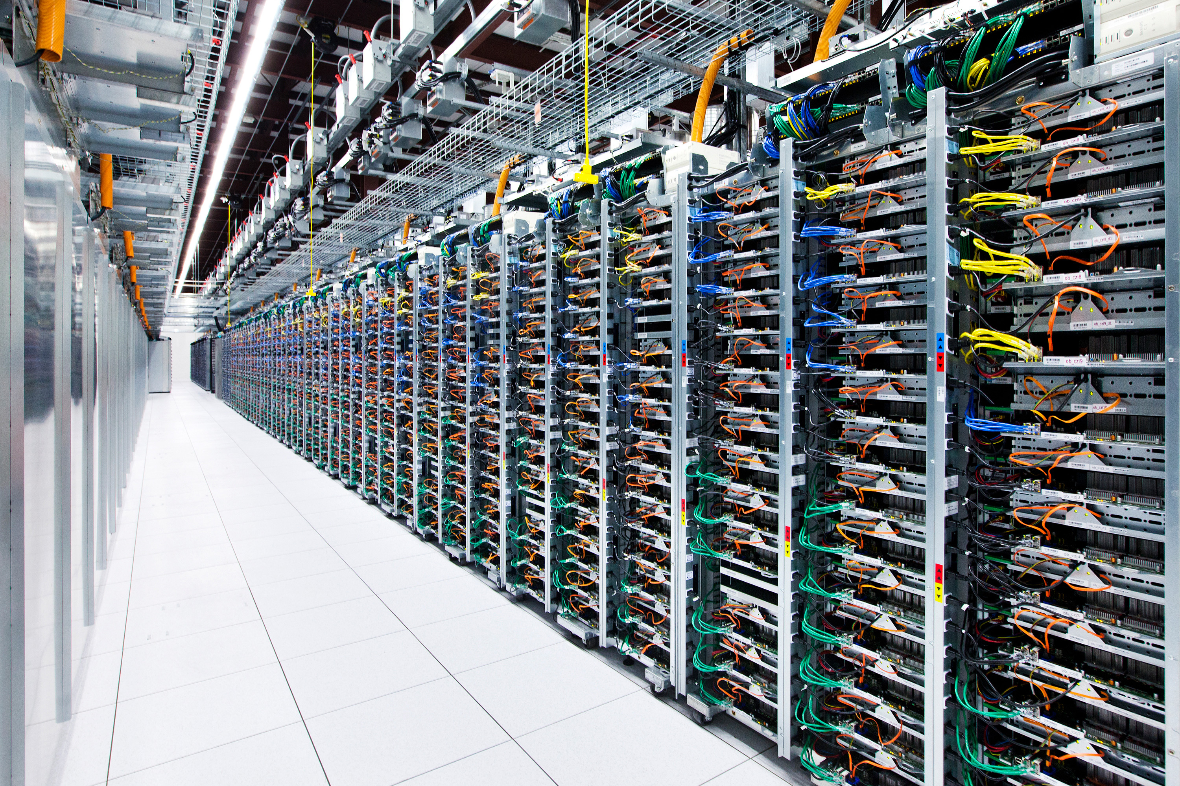

Slide 3

What inputs do SDN controllers see?
20,000 servers * 4 VMs / server = 80,000 VMs
(6 migrations / day / VM) +
(2 power up|down / day / VM) *
80,000 VMs = 640,000 VM events / day
~= 450 VM changes / minute [1]
8.5 network error events / minute [2]
1 policy change / tenant / day *
2000 tenants ~= 1 policy change / minute

Slide 4
What inputs do SDN controllers see?
= ~500 inputs / minute

Slide 5

Something goes wrong!

Slide 6
Best practice: Logs
Manual analysis of log files

Slide 7
Best practice: Logs
?
Controller A
Switch 1
Switch 2
Switch3
Controller B
Switch 4
Switch 5
Switch 6
Controller C
Switch 7
Switch 8
Switch 9

Slide 8
Goal
Identify the minimal sequence of inputs that triggers the bug

Slide 9
Minimal Causal Sequence

Slide 10
Minimal Causal Sequence
Crash
Master
Ping
Pong
Ping
Backup
Master
Notify
Notify
ACK
Blackhole persists!
Switch
Link Failure
Notes:
Is Rob Vaterlaus in the room?

Slide 11
Minimal Causal Sequence
Master
Ping
Pong
Backup
New Routing Table!
Link Down!
Blackhole resolved!
Switch
Link Failure

Slide 12
Minimal Causal Sequence
Master
Crash
Ping
Pong
Ping
…
Backup
Master
Blackhole avoided!
Switch

Slide 13
Minimal Causal Sequence
Both are necessary conditions!
Master
Crash
Ping
Pong
Ping
Backup
Master
Notify
Notify
ACK
Blackhole persists!
Switch
Link Failure

Slide 14
Minimal Causal Sequence
?
Controller A
Switch 1
Switch 2
Switch3
Controller B
Switch 4
Switch 5
Switch 6
Controller C
Switch 7
Switch 8
Switch 9
Notes:
OK, so how are we going to get from here…

Slide 15
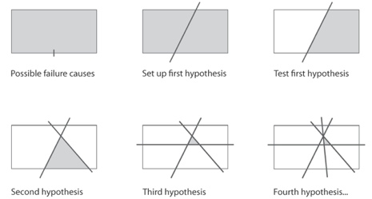
High-Level Approach
Modify history!
Notes:
If any of you are aware of the work, this technique is called delta debugging

Slide 16
Replay is Hard
Must consider internal events
Crash
Master
Ping
Seq=3
Pong
Seq=4
Ping
Seq=5
Timeout
Backup
Master
port_status
Xid=12
port_status
xid=13
ACK
Blackhole persists!
Switch
Link Failure
Timeout

Slide 17
Replay is Hard
Must consider internal events
Crash
Master
Ping
Seq=3
Pong
Seq=4
Ping
Seq=5
Timeout
Backup
New Routing Table!
Master
port_status
Xid=12
Blackhole resolved!
Switch
Link Failure

Slide 18

Pruning Alters Internal Events!

Slide 19
Pruning Alters Internal Events!
Prune Earlier Input..
Crash
Master
Ping
Seq=3
Pong
Seq=4
Ping
Seq=5
Timeout
Backup
Master
port_status
xid=12
port_status
xid=13
ACK
Blackhole persists!
Switch
Link Failure
Timeout

Slide 20
Pruning Alters Internal Events!
Sequence Numbers Differ!
Crash
Master
Ping
Seq=2
Pong
Seq=3
Ping
Seq=4
Timeout
Backup
Master
port_status
xid=11
port_status
xid=12
ACK
Blackhole persists!
Switch
Link Failure
Timeout

Slide 21
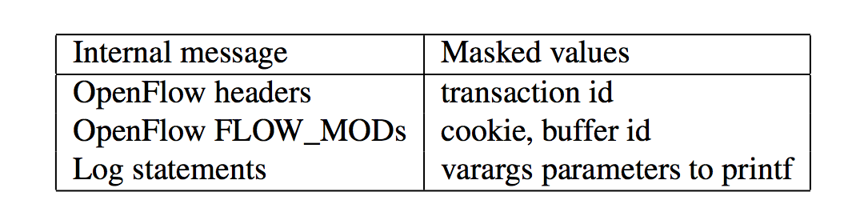
Solution: Equivalence Classes
Mask Over Extraneous Fields

Slide 22
Other Subtleties: Old/New Events
Pruning inputs may also cause:
Expected internal events to disappear
New internal events to appear

Slide 23
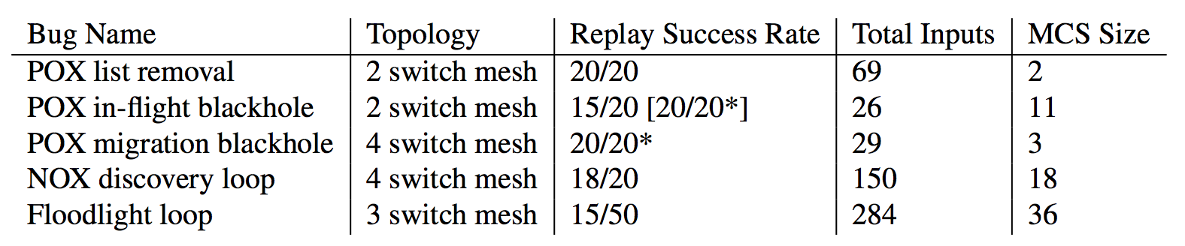
It Works!

Slide 24
It Works!

Slide 25
Simulator

Slide 26
Demo
sts demo

Slide 27
Summary
Goal: automatically diagnose network problems
Approach: iteratively alter history
Check us out:
ucb-sts.github.com/sts/

Slide 28
References
[1] V. Soundararajan and K. Govil. Challenges in building scalable virtualized datacenter management. SIGOPS Operating Systems Review ’10.
[2] A. Greenberg, J. R. Hamilton, N. Jain, S. Kandula, C. Kim, P. Lahiri, D. A. Maltz, P. Patel, and S. Sengupta. VL2: a scalable and flexible data center network, Sec. 3.4. SIGCOMM ’09.

Slide 29
Backup

Slide 30
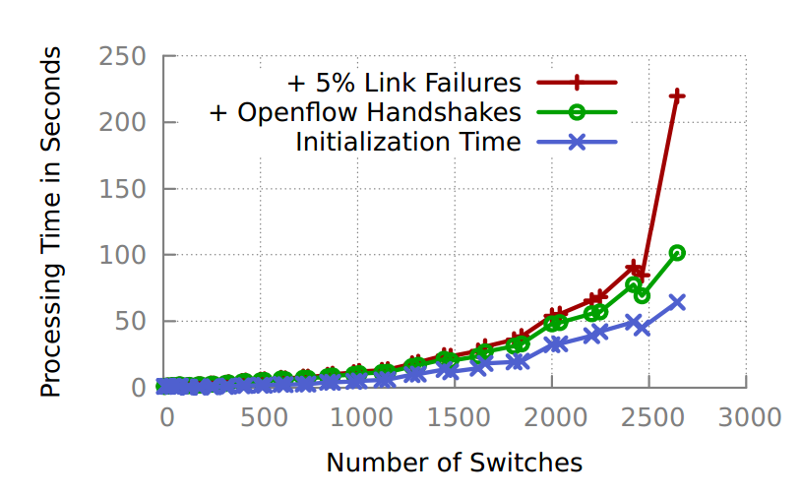
Scalability

Slide 31
Complexity
Best Case | Worst Case
Delta Debugging: O(log n) replays Each replay: O(n) events Total: O(nlog n) | Delta Debugging: O(n) replays Each replay: O(n) events Total: O(n²)
Notes:
Optimizations:
- can be parallelized
Can take periodic snapshots
Causal annotations

Slide 32
Coping With Non-Determinism
Replay multiple times per subsequence
Probability of not finding bug defined by Bernoulli Distribution:
Notes:
Hint: this is very small
Other tricks:
- multiplexed sockets
- override gettimeofday and rand
- interpose on logging library
- interpose on intra-controller messages

Slide 33
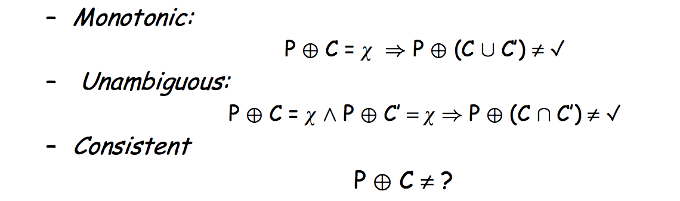
Assumptions of Delta Debugging

Slide 34
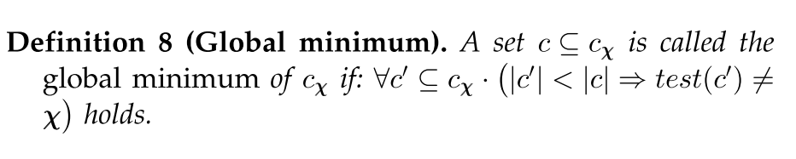
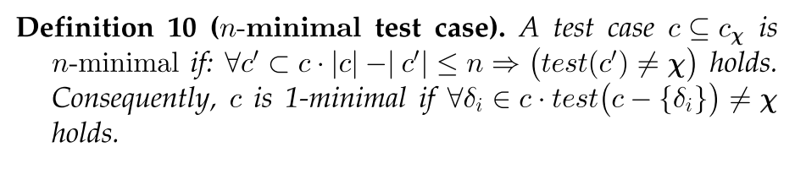
Local vs. Global Minimality

Slide 35
Problem Scope: Triage
Problem in policy? Change it
Problem in network hardware? Call up vendor
Else: problem in control software

Slide 36
Limited Visibility
Interpose on logging library to gain visibility into internal state changes
Still, may not obtain visibility into all relevant events!
Extreme case: need visibility into thread scheduling decisions.

Slide 37
Related Work
Delta Debugging, Sherlog, Rx, Chronus
OFRewind, ndb
Pip, X-trace
Mininet, ns-3
Model checkers: NICE, Mace
Root cause analysis

